Slide 1

Pivotal Tuning for Latent-based
Editing of Real Image
PTI
Kim Ha Yeon
Bachelor Student, UNIST
29th September, 2022

Slide 2
Summary
“Tune the pre-trained StyleGAN generator
with pivotal code(editable code)”

Slide 3
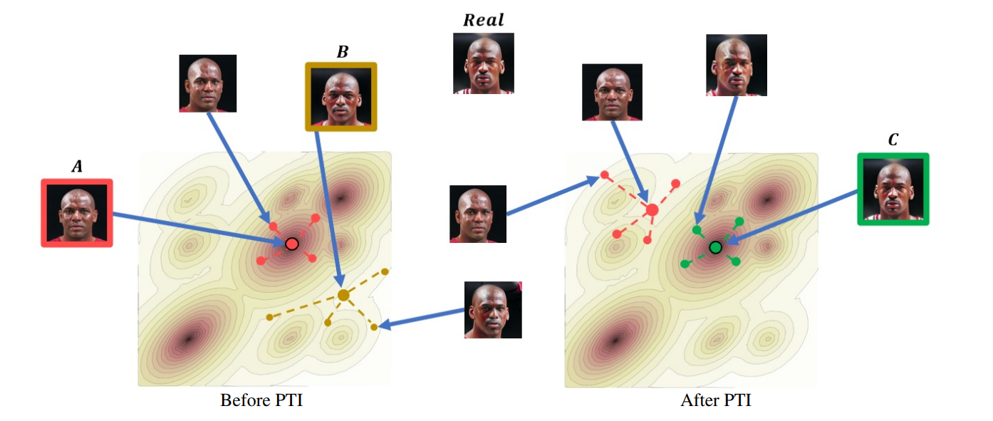
Introduction
StyleGAN : fantastic editing capabilities due to disentangled latent space
GAN inversion : find latent representation for editing a real image(distortion-editability trade-off)
W+ : weaker editability since they are not from the generator’s trained domain
Augment the manifold to include the image by slightly altering the generator(pivotal tuning)
Invert the input image to an editable latent code(W)
Pivotal Tuning : tune the pretrained StyleGAN – input image is generated when using the pivot latent code

Slide 4
Introduction

Slide 5
Related Work
■ Generator Tuning
Pidhorskyi et al : train encoder & generator -> but, significant distortion
Bau et al : directly updating the weights results in sensitivity to small changes in the input, inducing unrealistic artifacts
Pan el al : invert images to BigGAN’s latent space by optimizing a random noise vector and tuning the generator => optimizing a random vector decreases reconstruction & editiability

Slide 6
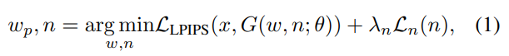
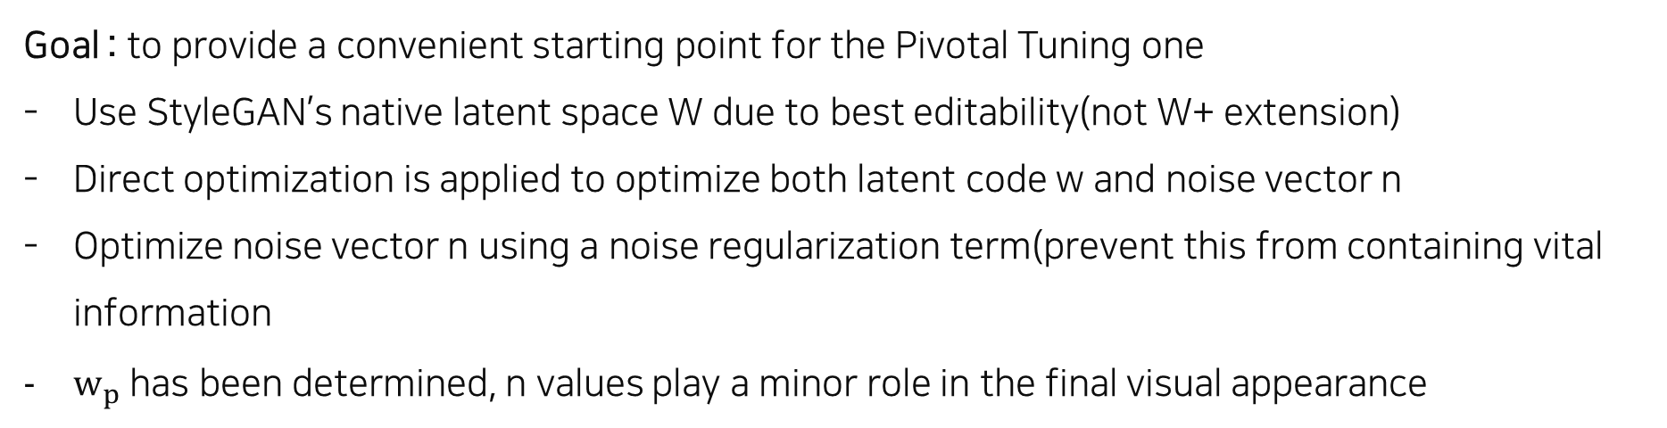
Method
■ Inversion
Goal : to provide a convenient starting point for the Pivotal Tuning one
Use StyleGAN’s native latent space W due to best editability(not W+ extension)
Direct optimization is applied to optimize both latent code w and noise vector n
Optimize noise vector n using a noise regularization term(prevent this from containing vital information
$w_{p}$ has been determined, n values play a minor role in the final visual appearance

Slide 7
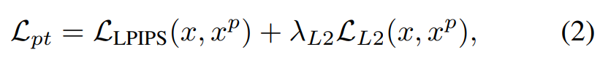
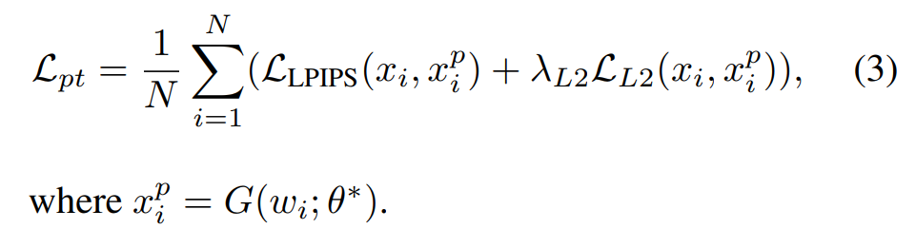
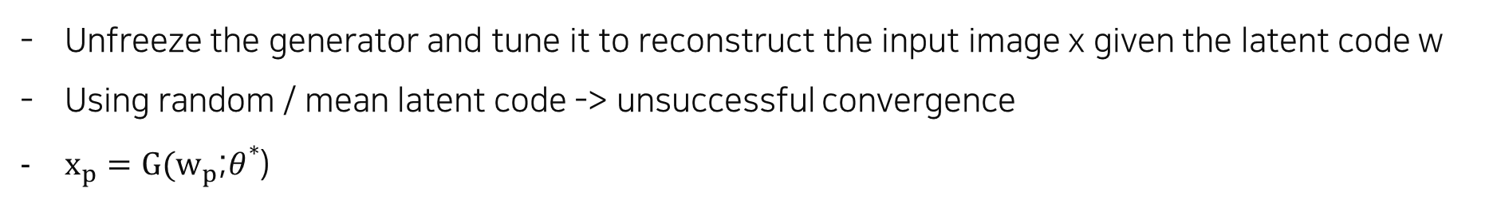
Method
■ Pivotal Tuning
Unfreeze the generator and tune it to reconstruct the input image x given the latent code w
Using random / mean latent code -> unsuccessful convergence
$x_{p}=G(w_{p}$;$θ^{*}$)
- The pivotal tuning can trivially be extended to N images {xi} N i=0, given the N inversion latent codes {wi} N i=0:

Slide 8
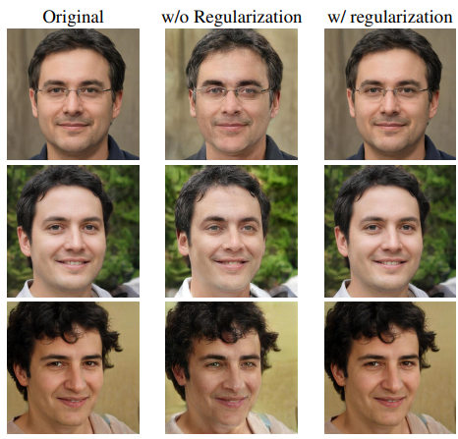
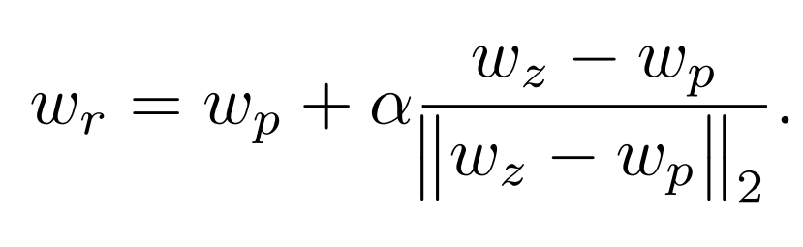
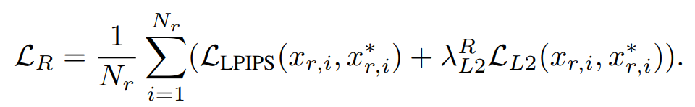
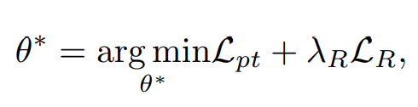
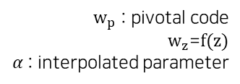
Method
■ Locality Regularization
Restrict the PTI changes to a local region in the latent space
Pivotal tuning : ripple effect(visual quality of images generated by non-local latent codes is compromised)
$w_{p}$ : pivotal code
$w_{z}$=$f(z)$
$α$: interpolated parameter

Slide 9
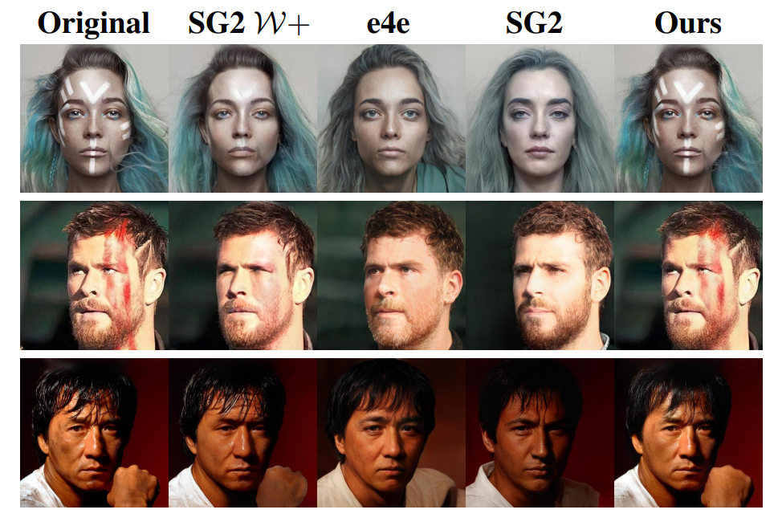
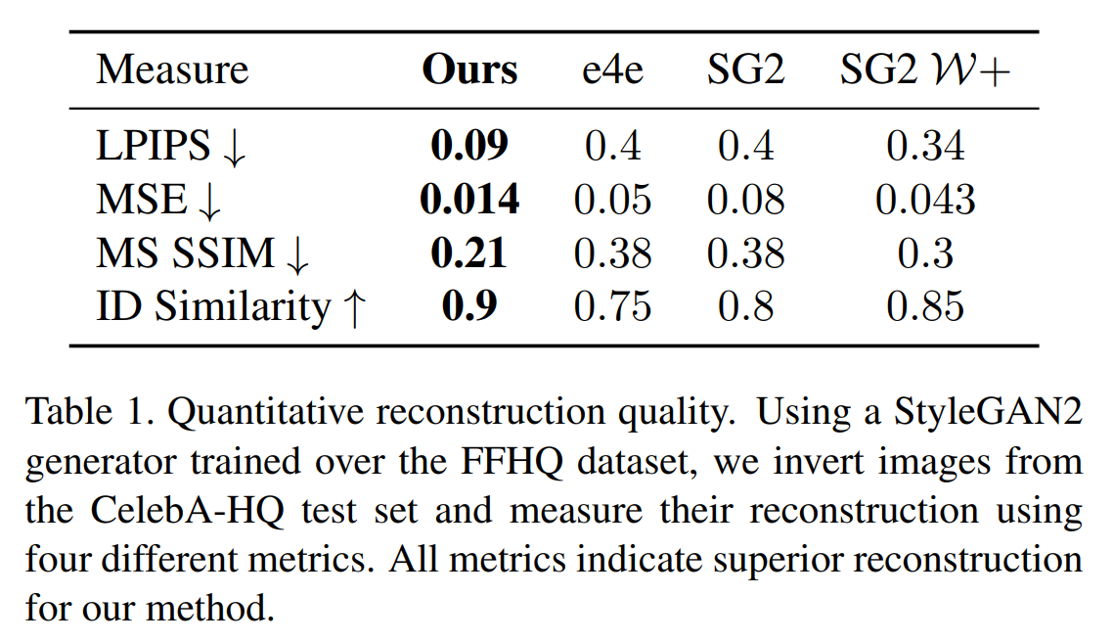
Experiments
■ Qualitative & Quantitative evaluation
out-of-domain

Slide 10
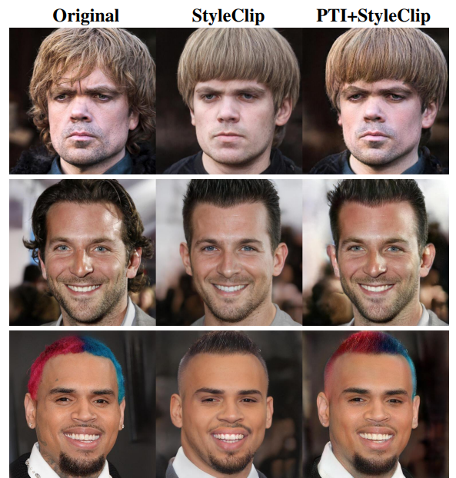
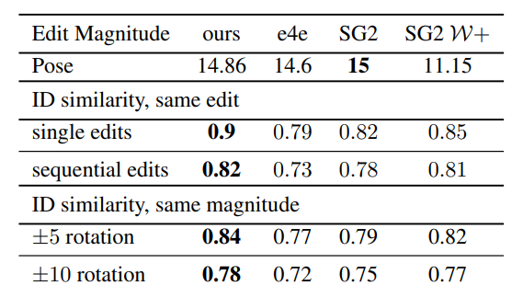
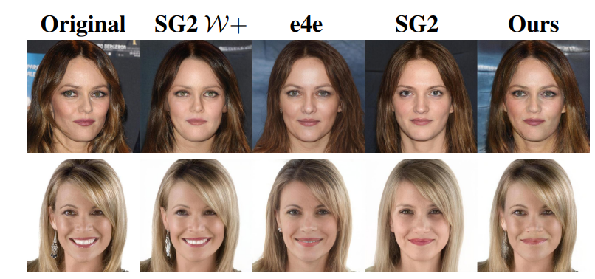
Experiments
■ Editing quality
(top) pose
(bottom) smile X
(1row) bowl cut
(2row) mohawk

Slide 11
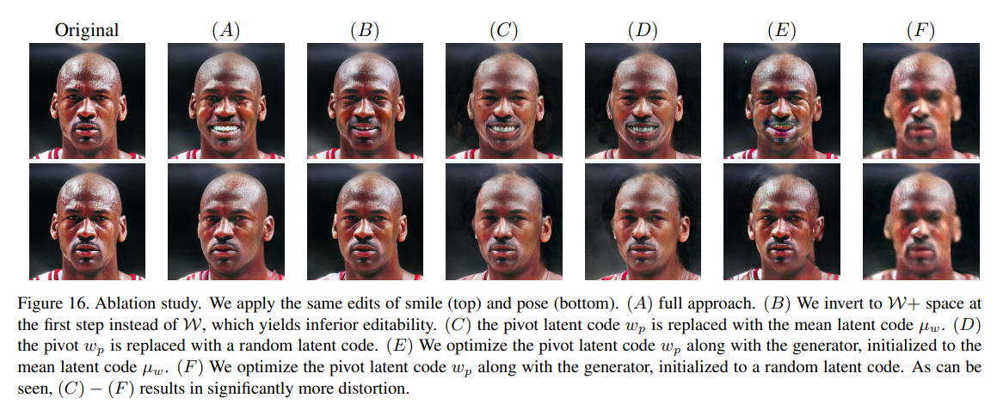
Experiments
■ Ablation Study

Slide 12
Kim Ha Yeon(rlagkdus705@unist.ac.kr)

